Slide 1
Cargo Fleet Tracking System
DISD 2 Group 1

Slide 2
Problem Domain
Develop software system
Must be designed for Mass production
Decrease workload for employees
Add another fulltime Administrator
Specifically develop a new Fleet Tracking system
Current System causes 3 errors on average per day, which can take up roughly 20 min to correct
Erase the time delay in new system by reducing the frequency of those errors

Slide 3
Functional requirements
Administrative capabilities
Tracking of transport vehicles
Maintenance of vehicle records
Office manager Application user management
Vehicle information Administration
Trip Management
Scheduling of vehicle trips
Fuel usage recording
Incident recording
Service management
Appointment management
Daily service goal preparation
Timesheet Management
Track hours worked by drivers and mechanisms

Slide 4
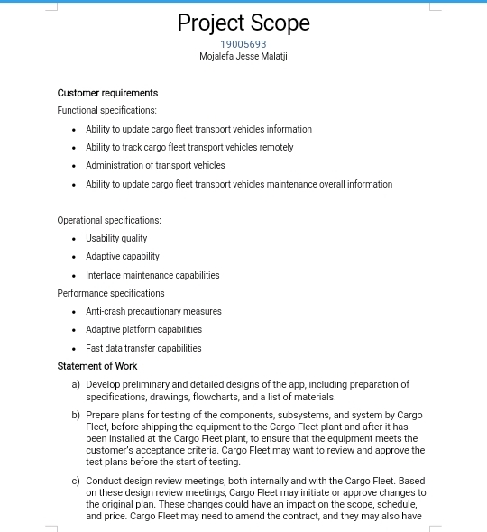
PROJECT SCOPE FOR FLEET TRACKING SYSTEM

Slide 5
Budget for the deliverables
Fully functional vehicle tracking system: R250 000
Fully adaptive software: R150 000
Maintainable system software: R50 000
Overall budget for the project is R500 000

Slide 6
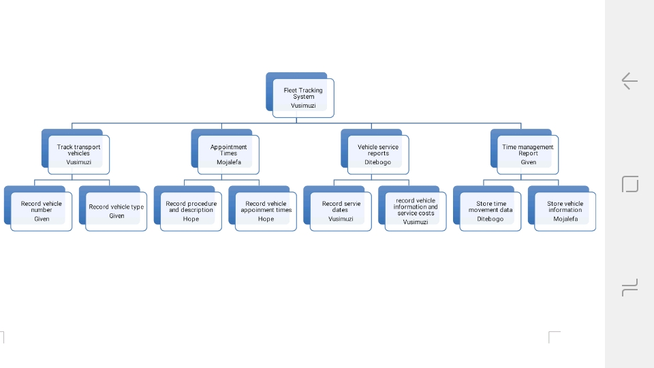
WORK BREAKDOWN STRUCTURE

Slide 7
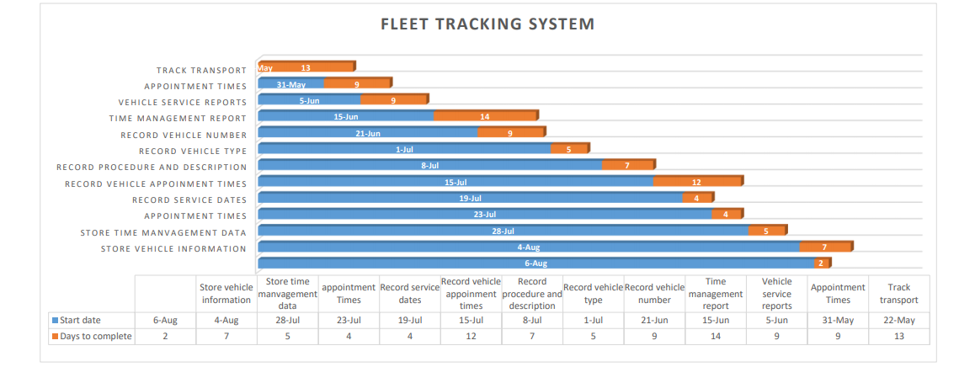
Ghant Chart

Slide 8
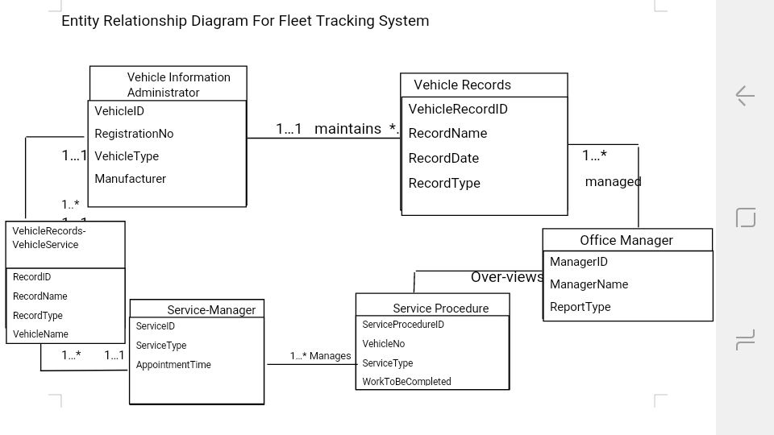
ERD

Slide 9
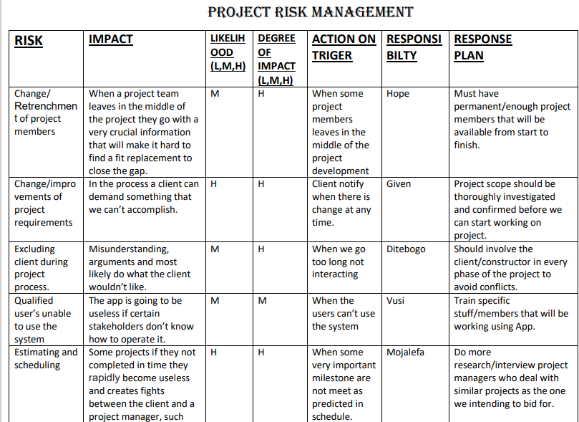
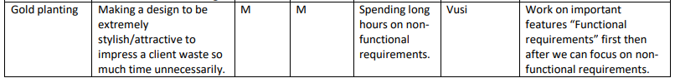
Risk Management

Slide 10
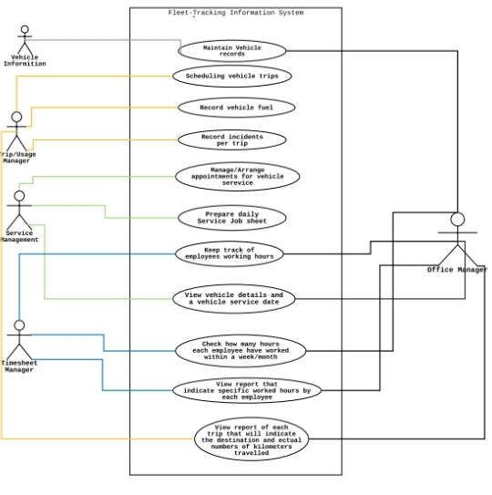
USE-CASE DIAGRAM FOR FLEET TRACKING SYSTEM

